Slide 1
Recap: Lecture 4: 13th January 2014, 1130-1230 hrs.
Energy transfer mechanisms
Heat transfer, adiabatic process
Work
Path and point functions

Slide 2
Path and Point functions
Path functions
Have inexact differentials, sometimes designated by symbol, δ or đ
Eg. δQ or đQ and δW or đW instead of dQ and dW
Point functions
Have exact differentials, designated by symbol, d
Eg. dP, dV, dT

Slide 3
Path and Point functions
_{p}
ΔV=4m³; W_{A}=10 kJ
ΔV=4m³; W_{B}=15 kJ
₁
Process B
₂
Process A
_{1m}³
_{5m}³
_{V}
Properties are point functions,
eg. P, T, v, h (enthalpy), s (entropy), c_{p},c_{v} etc.

Slide 4
Work
Work done by a system on its surroundings during a process is defined as that interaction whose sole effect external to the system could be viewed as the raising of a mass through a distance against gravity.

Slide 5
Work
System
boundary
Fan
Motor
_
W
+
Battery
Surroundings

Slide 6
Work
System
boundary
Motor
Pulley
_
+
Weight
Battery
Surroundings

Slide 7
Work
Examples:
PdV: displacement work
Electrical work: heating of a resistor
Shaft work: rotation of a shaft
Paddle wheel work
Spring work
Stretching of a liquid film

Slide 8
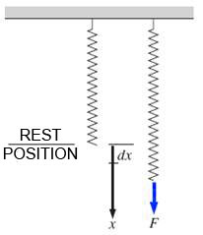
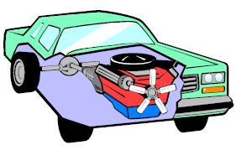
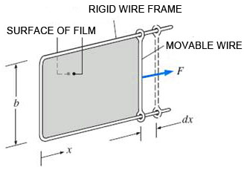
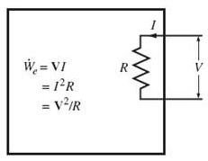
Work
Shaft work: rotation of a shaft
Spring work
Electrical work: heating of a resistor
Stretching of a liquid film

Slide 9
Displacement work
Moving boundary or displacement work is of significant interest to engineers.
Many engineering systems generate useful work output by this mode.
Examples: automobile engines, steam engines, pumps etc.

Slide 10
Displacement work
F
A gas does a differential amount of work δW_{b} as it forces the piston to move by a differential amount ds
A
ds
P

Slide 11
Displacement work
P
1
Process path
dA=P dV
2
The area under the process curve on a P-V diagram is equal, in magnitude, to the work done during a quasi-equilibrium expansion or compression process of a closed system.
V₁
dV
V₂
V
P

Slide 12
Displacement work
P
W_{A} = 12 kJ
W_{B} = 10 kJ
1
W_{C} = 7 kJ
A
B
C
2
V₁
V₂
V
The boundary work done during a process depends on the path followed as well as the end states.

Slide 13
Displacement work
P
1
A
W_{net}
B
2
V₁
V₂
V
The net work done during a cycle is the difference between the work done by the system and the work done on the system.

Slide 14
Displacement work
Displacement work during various
processes:
Constant pressure process
Constant volume process
PV= constant
Polytropic process, PV^{n} = constant

Slide 15
Constant pressure process
P
1
2
W₁₋₂
V₁
V₂
V

Slide 16
Constant volume process
P
1
P₁
P₂
2
V

Slide 17
PV^{n} = constant (Polytropic processes)
1
n=0
2
PV^{n} =constant
n=1
n=∞
n=2
n=3
V

Slide 18
Joule’s experiment
Joule’s experiment (1840-1849) to investigate the equivalence of heat and work.
Prior to Joule, heat was considered to be a invisible fluid known as caloric and flows from a body of higher caloric to one with a lower caloric.
Caloric theory of heat
Joule’s experiment laid the foundation of the first law of thermodynamics.

Slide 19
Joule’s experiment
Work, W₁₋₂ done on the system can be measured by the fall of the weight.
The system temperature rises as work is done on the system.
Let the insulation now be removed.
The system reaches its initial state by heat transfer across the system boundaries.
Therefore the work done is proportional to the heat transfer.
The constant of proportionality is the Joule’s equivalent.

Slide 20
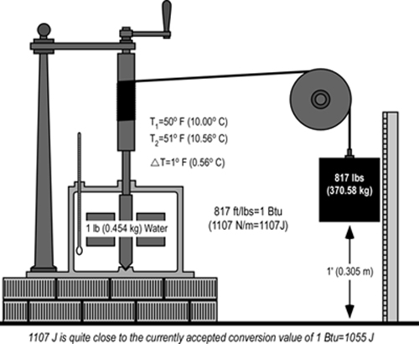
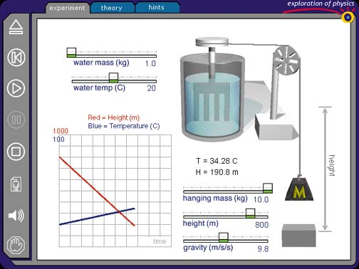

Slide 21
Joule’s experiment
y
2
Q₂₋₁
W₁₋₂
1
x
The cycle consists of two processes, one an adiabatic work transfer followed by heat transfer

Slide 22
First law of thermodynamics
Conservation of energy principle
Energy can neither be created nor destroyed, it can only be converted from one form to another.
For all adiabatic processes between two specified states of a closed system, the net work done is the same regardless of the nature of the closed system and the details of the process.

Slide 23

First law of thermodynamics
m
PE = 12 kJ
KE = 0 kJ
Energy cannot be created or destroyed; it can only change forms
Δz
m
PE = 8 kJ
KE = 4 kJ

Slide 24

First law of thermodynamics
Q_{out} = 5 kJ
Q_{in} = 10 kJ
ΔE=Q_{net}=20 kJ
Potato
ΔE = 10 kJ
Q_{in} = 25 kJ
The increase in the energy of a potato in an oven is equal to the amount of heat transferred to it.
In the absence of any work interactions, the energy change of a system is equal to the net heat transfer.

Slide 25
First law of thermodynamics
Adiabatic
Adiabatic
W_{in}=10 kJ
ΔE=10 kJ
W_{in}=10 kJ
ΔE=10 kJ
_
+
Battery
The work done on an adiabatic system is equal to the increase in energy of the system.
Change in total energy during an adiabatic process is equal to the net work done.

Slide 26
Energy balance
The net change (increase or decrease) in the total energy of a system during a process is equal to the difference between the total energy entering and total energy leaving the system.

Slide 27
Energy change of a system
Energy change = Energy at the final state – Energy at the initial state
In the absence of electrical, magnetic or surface tension effects,
∆E = ∆U + ∆KE + ∆PE
Thus, for stationary systems,
∆E = ∆U

Slide 28
Energy change of a system
Q_{out} = 5 kJ
ΔE= (Q_{in}-Q_{out})+W_{in}
= (25-5) + 8
= 28 kJ
W_{in}=8 kJ
Q_{in} = 25 kJ
The energy change of a system during a process is equal to the net work and heat transfer between the system and its surroundings

Slide 29
Energy transfer mechanisms
Energy can be transferred to or from a system by three mechanisms
Heat
Work
Mass flow

Slide 30
Energy transfer mechanisms
For constant rates, the total quantities during a time interval t are related to the quantities per unit time as

Slide 31
First law for a cycle
For a closed system undergoing a cycle, the initial and final states are identical.
Therefore, ΔE_{system}= E₂ - E₁ = 0
The energy balance for a cycle simplifies to
E_{in} - E_{out} = 0 or E_{in} = E_{out}

Slide 32
First law for a cycle
A closed system does not involve any mass flow across its boundaries, the energy balance for a cycle can be expressed in terms of heat and work interactions as

Slide 33
First law for a cycle
P
Q_{net} = W_{net}
V
For a cycle, ΔE = 0, thus Q_{net} = W_{net}

